Slide 1

Industrial-Organizational Psychology
Chapter 13

Slide 2
Agenda
What is I-O Psychology?
Industrial Psychology
Organizational Psychology
Human Factors Psychology

Slide 3

What is the focus of each area of I-O psychology?
Industrial psychology
Hiring and training for a job
Organizational psychology
Social climate of the workplace
Human factors psychology
Optimizing tools/systems for use in the workplace

Slide 4
Industrial Psychologist
Description
Specializes and focuses on the retention of employees and hiring practices to ensure the least number of firings and the greatest number of hirings relative to the organization’s size.
Types of Jobs
Personnel Analyst
Instructional Designer
Professor
Research Analyst

Slide 5
Organizational Psychologist
Description
Works with the relationships that employees develop with their organizations and conversely that their organization develops with them. In addition, studies the relationships that develop between co-workers and how that is influenced by organizational norms.
Types of Jobs
HR Research Specialist
Professor
Project Consultant
Personnel Psychologist
Test Developer
Training Developer
Leadership Developer
Talent Developer

Slide 6
Human Factors and Engineering
Description
Researches advances and changes in technology in an effort to improve the way technology is used by consumers, whether with consumer products, technologies, transportation, work environments, or communications. Seeks to be better able to predict the ways in which people can and will utilize technology and products in an effort to provide improved safety and reliability.
Types of Jobs
Professor
Ergonomist
Safety Scientist
Project Consultant
Inspector
Research Scientist
Marketer
Product Development

Slide 7
Sub-Specialties in I-O Psychology
Humanitarian Work Psychologist
Works to improve the conditions of individuals who have faced serious disaster or who are part of an underserved population. Focuses on labor relations, enhancing public health services, effects on populations due to climate change, recession, and diseases.
Ex: Consultant, research scientist
Occupational Health Psychologist
Concerned with the overall well-being of both employees and organizations.
Ex: occupational therapist, research scientist, HR specialist

Slide 8
How I-O Psychology Began
1903
Walter Dill Scott published The Theory of Advertising and Psychology of Advertising
1911
Scott published Influencing Men in Business and Increasing Human Efficiency in Business
1911
Hugo Münsterberg published Psychology and Industrial Efficiency
1916
Carnegie Institute of Technology hired Scott to help with employee selection
1917
Creation of the Army Alpha and Beta tests
1929–1932
Elton Mayo began project on workplace dynamics; led to findings of Hawthorne effect
1913
Frederick Taylor illustrated people were more efficient when allowed rest

Slide 9
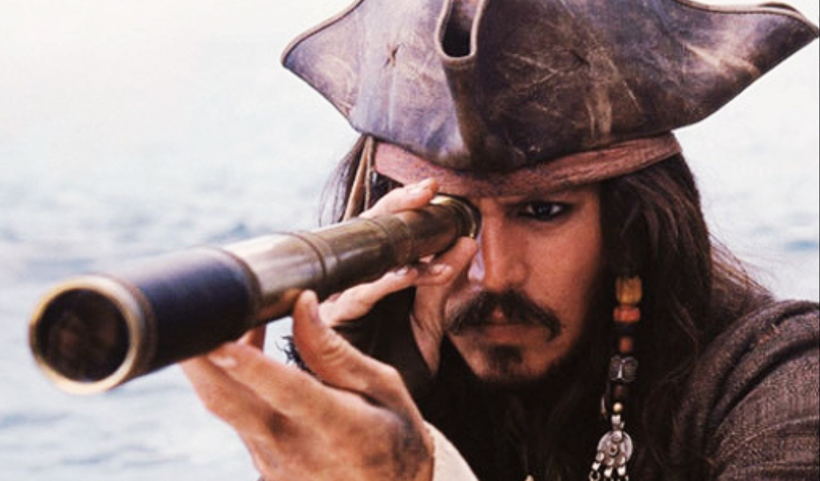
How might being watched impact how people act?
Hawthorne effect – the increase in performance of individuals who are noticed, watched, and paid attention to by researchers or supervisors

Slide 10
Industrial Psychology
Job analysis
O*Net
Interviews
Performance appraisals
https://www.onetonline.org/

Slide 11
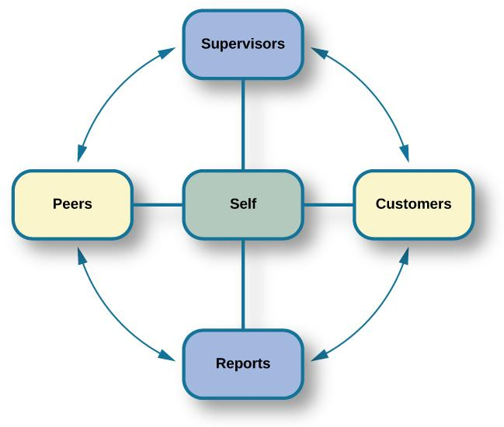
360-Degree Feedback Appraisal
Supervisors, customers, direct reports, peers, and the employee himself rate an employee’s performance.
Provides different perspectives of employees’ job performance.
Often fail to accomplish their purpose because they are used incorrectly.

Slide 12
Legalities
U.S. Equal Employment Opportunity Commission (EEOC)
Title VII of the Civil Rights Act of 1964
The Age Discrimination in Employment Act of 1967
Titles I and V of the Americans with Disabilities Act of 1990 (ADA)
Bona fide occupational qualifications (BFOQs)

Slide 13
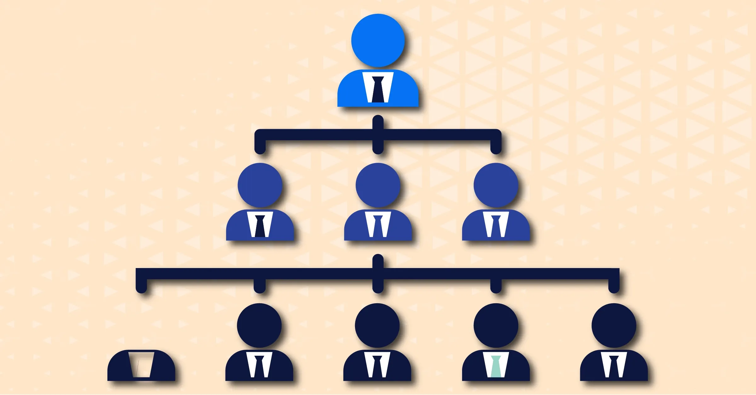
Organizational Psychology

Slide 14
What do you think impacts job satisfaction?

Slide 15
What do you think a healthy balance between work and family entails?

Slide 16
Douglas McGregor – Scientific Management Theory: A theory of management that analyzed and synthesized workflows with the main objective of improving economic efficiency, especially labor productivity. Two main styles: Theory X and Theory Y
Theory X | Theory Y
People dislike work and avoid it. | People enjoy work and find it natural.
People avoid responsibility. | People are more satisfied when given responsibility.
People want to be told what to do. | People want to take part in setting their own work goals.
Goals are achieved through rules and punishments. | Goals are achieved through enticements and rewards.

Slide 17
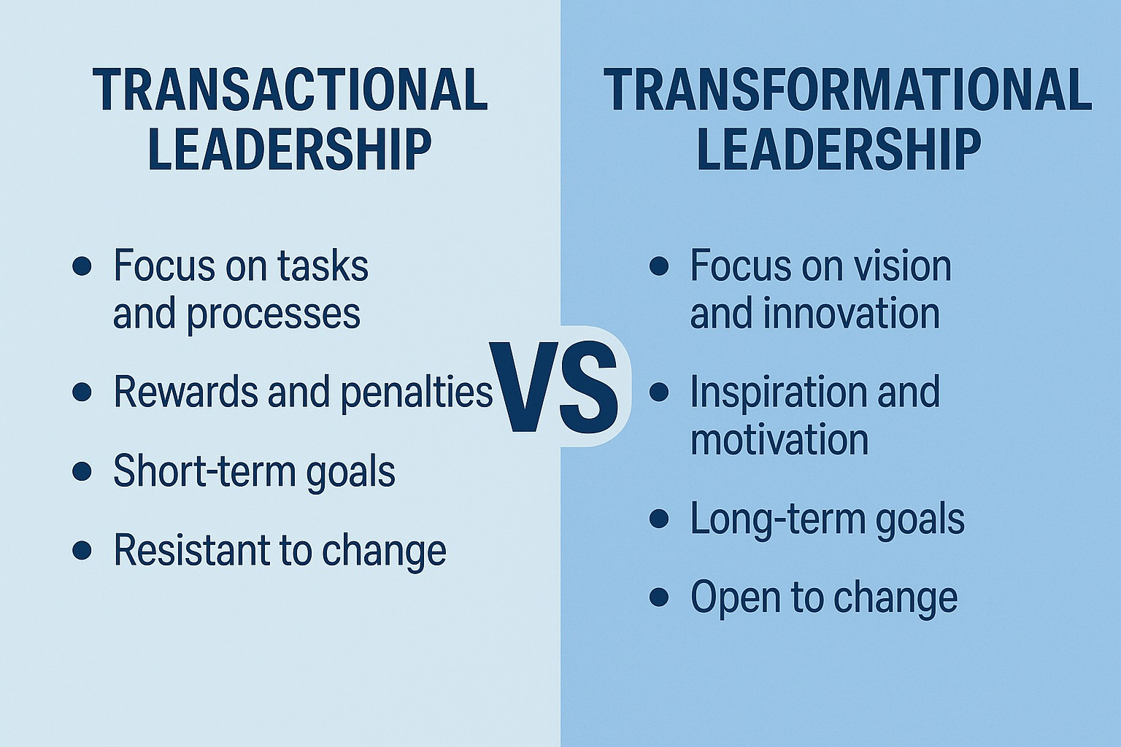

Slide 18
Things that Impact Work Environment
Ability to work as a team
Organizational culture
Diversity training
Sexual harassment
Workplace violence
Procedural justice

Slide 19

Human Factors Psychology

Slide 20
Areas of Study in Human Factors Psychology
Area | Description | I-O Questions
Attention | Includes vigilance and monitoring, recognizing signals in noise, mental resources, and divided attention | How is attention maintained? What about tasks maintains attention? How to design systems to support attention?
Cognitive engineering | Includes human software interactions in complex automated systems, especially the decision-making processes of workers as they are supported by the software system | How do workers use and obtain information provided by software?
Task analysis | Breaking down the elements of a task | How can a task be performed more efficiently? How can a task be performed more safely?
Cognitive task analysis | Breaking down the elements of a cognitive task | How are decisions made?

Slide 21
Next time on PSY 203…
BEFORE NEXT CLASS:
Study for Exam 3
Remember distributed practice!
NEXT CLASS:
Exam 3

